Slide 1
Knuckles, The Robotic Arm
Andrew Blanchard, Matthew van Zuilekom, Rym Benchaabane, Paola Hernandez
ECE 4335: ECE Systems Design

Slide 2
Background Info. and Research
Multitasking lifestyle
Current Biology: shifting focus and attempting to multitask reduces productivity by around 40%
SMF Mutual Insurance adds that multitasking can lead to dexterity incidents while performing hands-on work
Notes:
In today’s society, people are rushed and tend to multitask
According to research from the scientific journal, Current Biology, shifting focus and attempting to multitask reduces productivity by around 40%.
SMF Mutual Insurance adds that multitasking can lead to dexterity incidents while performing hands-on work.

Slide 3
Problem & Need
Problem: people tend to multitask
Consequence:
Dexterity incidents
Time consumption
Increase of production or research costs
Need
Avoid dexterity accidents
A helping hand
More flexibility
Reduce time searching for items
Notes:
Replace image with reflection image
Problem: People tend to multi-task and have to worry about multiple actions at once.
This can lead to dexterity incidents, increasing time and sometimes costs in case of production or research contexts.
Needed: Avoid dexterity accidents. Knuckles provides a literal helping hand, flexibility; allowing a scientist to work without human assistance and still achieve results.
To reduce time searching for items, reduce injury, reduce wasted research time. Researcher can work on their own if no other scientist is available.

Slide 4
Overall Project
What is Knuckles?
Assistive robotic arm that will hand the user requested objects and tools
Purpose
Increase the user’s productivity
Decrease the risk of dexterity incidents
Notes:
Knuckles: Assistive robotic arm that will hand the user requested objects and tools
Purpose: Assistant that will increase the user’s productivity and decrease the risk of dexterity incidents

Slide 5
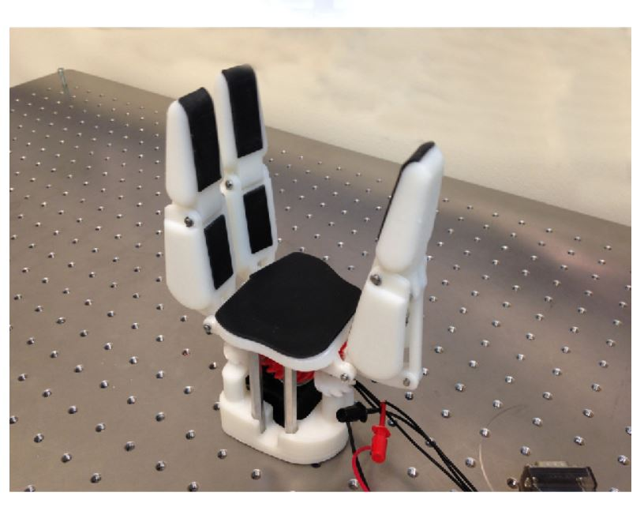
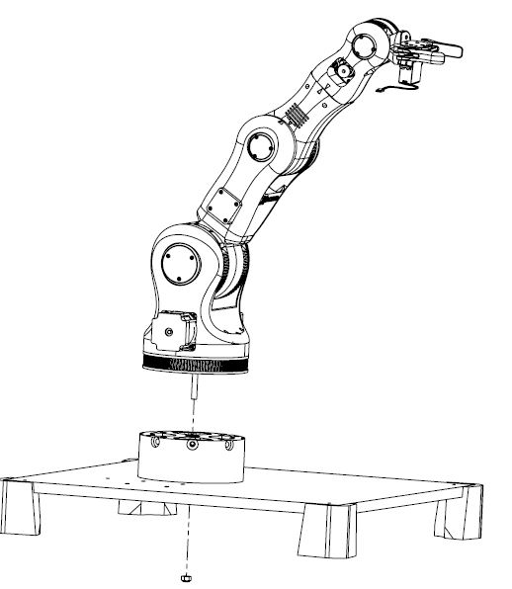
Meet Knuckles!
BCN3D Technologies – BCN3D Moveo (Spain)
Three-Finger Underactuated Adaptive Gripper (Kazakhstan/Australia)
Notes:
Replace image with reflection image

Slide 6
Deliverables
Fall 2018:
Physical arm and gripper prototype build
Hardware (Intel RealSense Camera, Multidirectional Mic, tactile pads)
Simulation using Rviz on ROS
Text commands
Object recognition
Manual control of arm and gripper
Spring 2019 [ Mid-March ]
Complete software and automation
Voice commands
Object recognition
Fully built robot:
Tuned gripper and arm
For a fully functional robot!
Notes:
Replace image with reflection image

Slide 7
User Analysis
Examples of users
Lab researchers
Mechanics
People with disabilities
User training requirement
Not much training; only voice commands
User support requirements
Power plug
Computer
Program to activate key words for voice commands (GUI)
Notes:
Knuckles is currently being developed for lab researchers, mechanics and people with disabilities.
Knuckles can be used for residential purposes.
Users will not require much training, as Knuckles will be controlled through voice commands.
Knuckles will be in need of a power plug, computer, program to activate key words for voice commands.

Slide 8
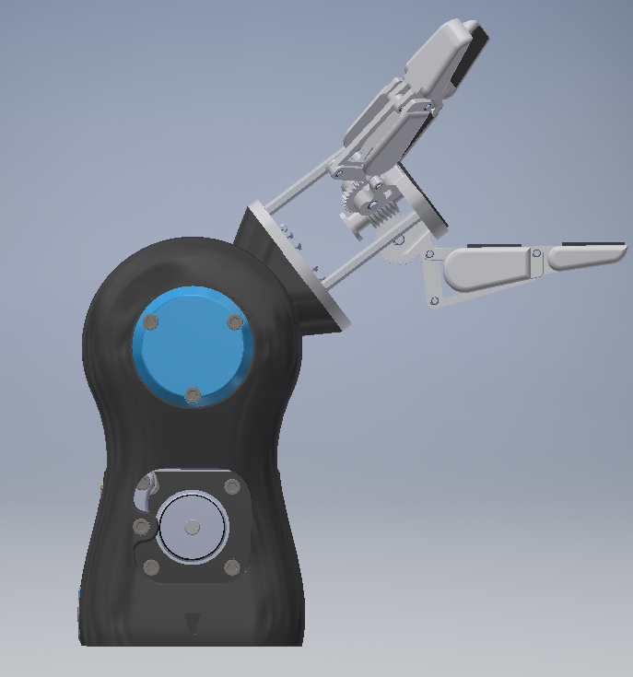
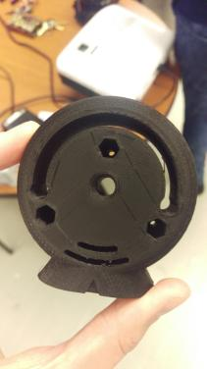
Current Progress

Slide 9
Significance
Advantages
Convenience
Productivity
Cost effectiveness
All potential users willing to use an extra hand:
Technicians
People with disabilities
Open-source robotics community
Researchers etc.
Best Application
Conducting hands-on work & not able to get up from work
Effectively find objects
Notes:
Replace image with reflection image

Slide 10
Division of Labor
Andrew – Team Leader - Computer and Embedded Systems Engineer
Skills: Robotics, OpenCV and Programming
Tasks
Build the arm and gripper
Install hardware on robot
Robot motion simulation on ROS
Matthew - Computer and Embedded Systems Engineer
Skills: Robotics, Programming and ROS
Tasks
ROS simulation and 3D mapping
Modify gripper design
Build the arm and gripper
Notes:
Replace image with reflection image

Slide 11
Division of Labor
Paola – Computer Engineer
Skills: Programming, Robotics, Embedded Systems
Tasks
ROS simulation and actual object recognition
Programming
Build the arm and gripper
Rym – Signals, Controls and Communications Engineer
Skills: Voice Analysis Project, Algorithms and Programming
Tasks
Voice recognition software and simulation
Modify gripper design
Build the arm and gripper
Notes:
Replace image with reflection image

Slide 12
Project Conclusion
Multitasking can be:
Impractical
Sometimes dangerous
Time consuming
Knuckles is a robotic arm:
Assist user with handing requested tools through voice commands
Make task more convenient
Accomplish work goals more efficiently
Notes:
To summarize, multitasking can be impractical, sometimes dangerous, and time consuming.
Knuckles is a robotic arm that will assist the user with handing requested tools through voice commands to make the task more convenient and accomplish work goals more efficiently.

